Slide 1



BOOKHAVEN
SANDEEP SHAW
PRATHAM SAVANE
RAHUL KAPARDAR
SAUMYA AGRAWAL
1

Slide 2


PROBLEM
Design a Database System for an online book store
Customers will use an web based interface to browse books based on categories, search books using keywords. Can get recommendations of books based on intertest and books can be purchased using e-purse
2

Slide 3

INTRODUCTION
BOOKHAVEN facilitate:
secure authentication
fast database operation
Personalized recommendation using ml
user friendly interface
3

Slide 4


Customer login & Admin login
- profile management ,track delivery status, create Wishlist and receive recommendations
Browse books by categories, search using keywords & purchase books via e-purse
With E-mail triggers customer is notified of delivery status.
Reviews and Recommendations on the basis of “Customers who bought this also bought this”
If book out of stock request to buy & when requested book in stock inform customer
On click get book info and abstract
4

Slide 5
FEATURES
Customer login & Admin login
Order items
Orders
Wishlist
Give delivery status to customer
Email
E-purse
Reviews
If book out of stock request to buy
When requested book in stock inform customer
Book Recommendation
4

Slide 6
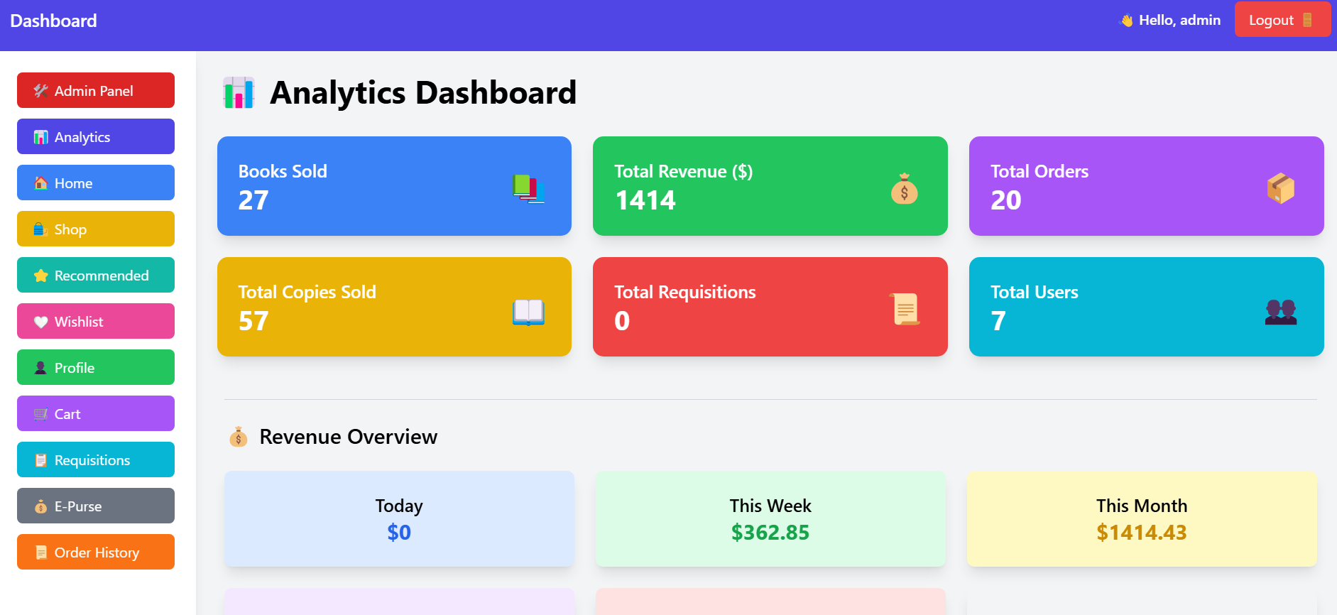
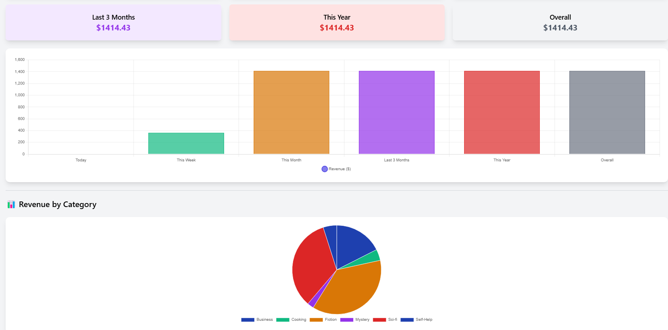

5

Slide 7
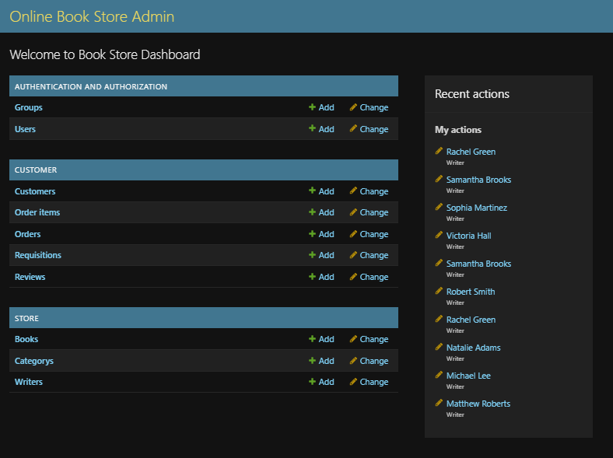

5

Slide 8

CATEGORIES
Categorizes the books
on the basis of their gener
like Arts,Drama, Children, Self-Help
Mistry,Fiction,Non-Fiction etc
21

Slide 9
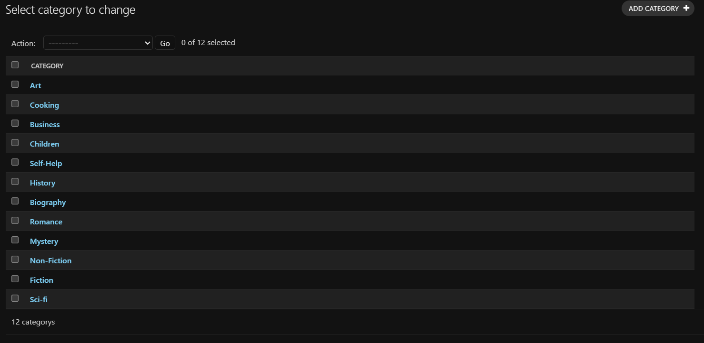
22

Slide 10

WRITERS
Categorizes books on the basis of writers
23

Slide 11
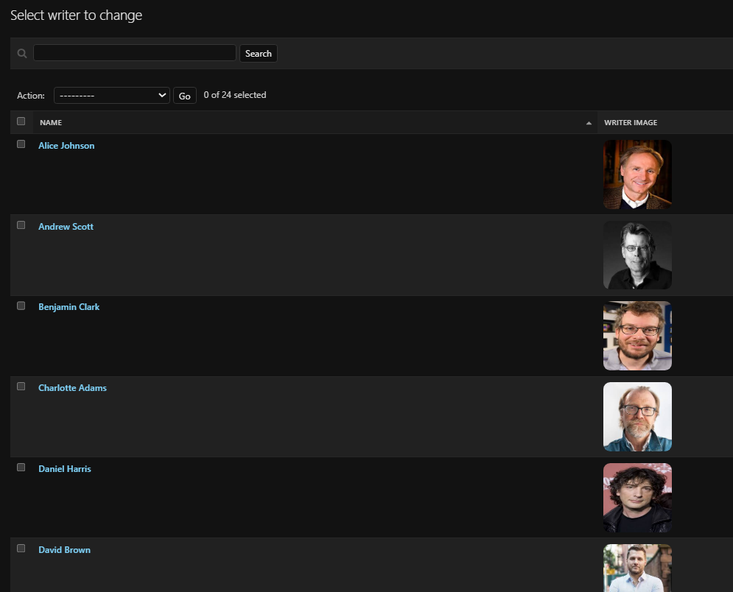
20

Slide 12

BOOKS
Contains the raw list of all books in
online store available with sellers
that are available on application.
19

Slide 13
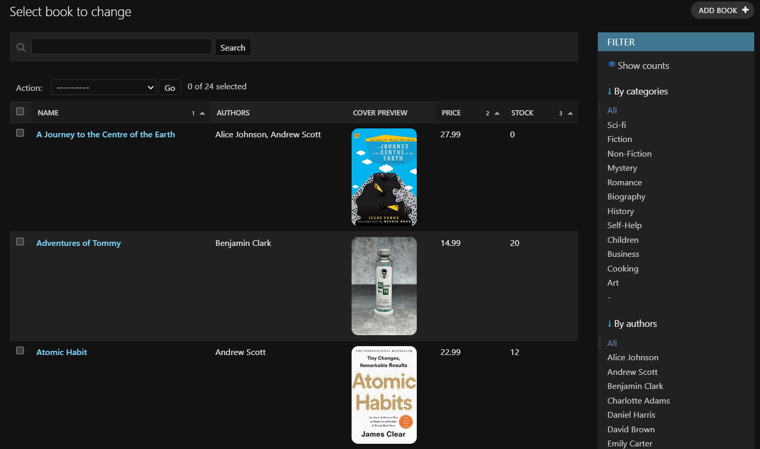

20

Slide 14
CUSTOMERS
Customers can create profile and access application to purchase the book .
6

Slide 15
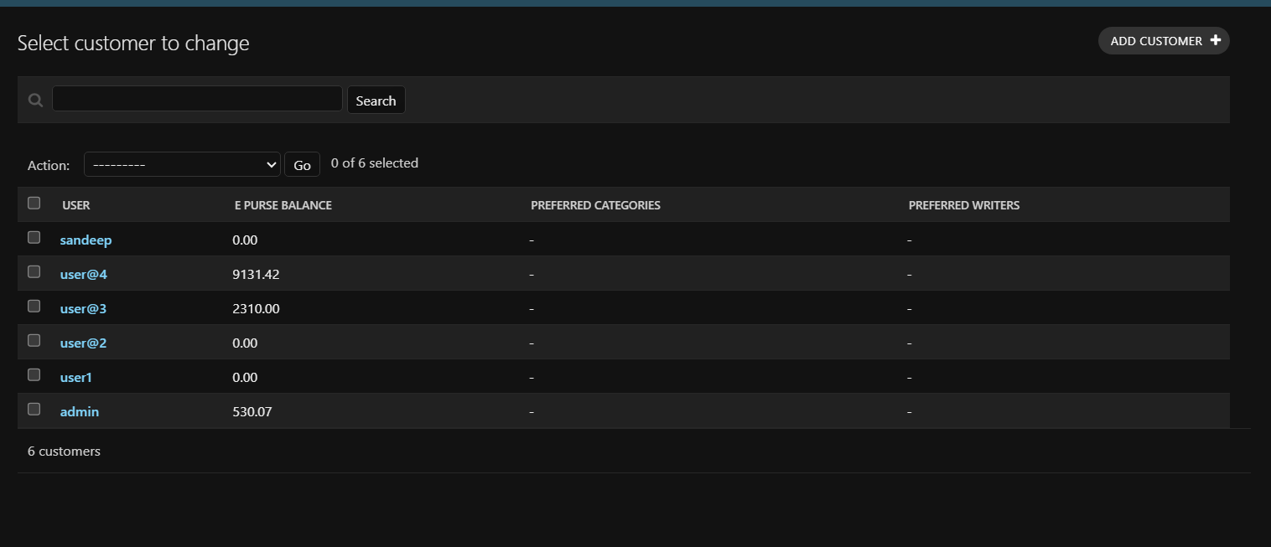
7

Slide 16

ORDER ITEMS
Contains list of all books purchased till date by customer using that id
8

Slide 17
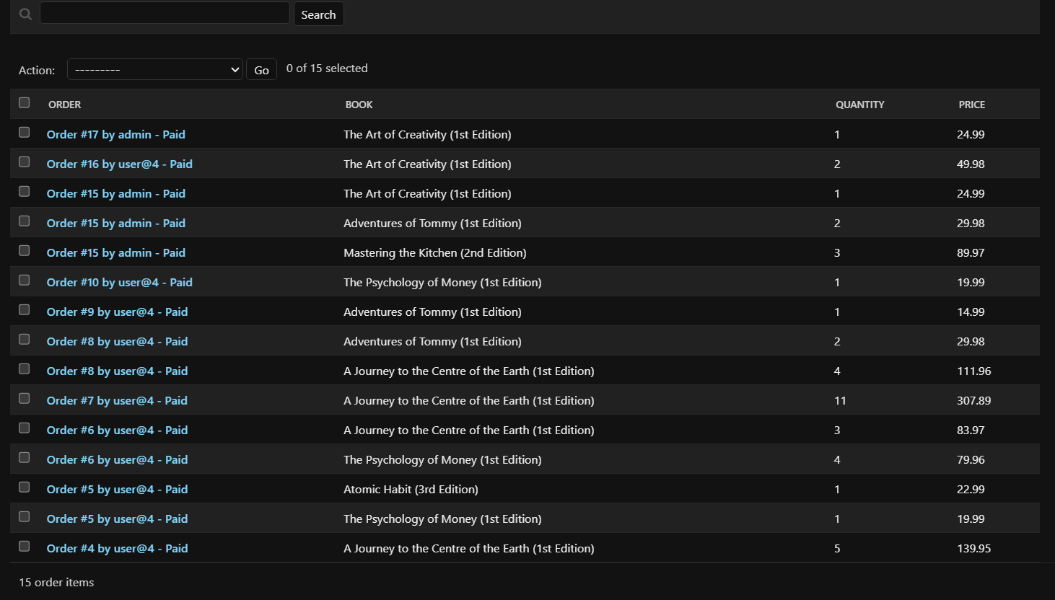
9

Slide 18

ORDERS
Contains the respective book bill history of each book purchased till now
10

Slide 19
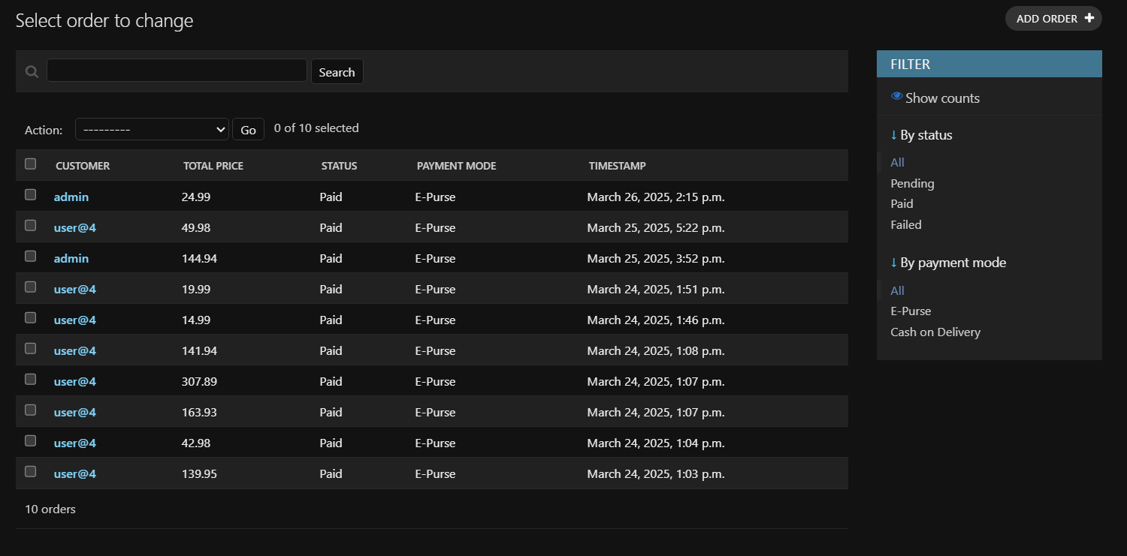
11

Slide 20

REQUISITIONS
If in any case the book demanded by customer is not available then customer can place a request and the request can be tracked. When the book will again come back in stock then customer will be informed via mail
12

Slide 21
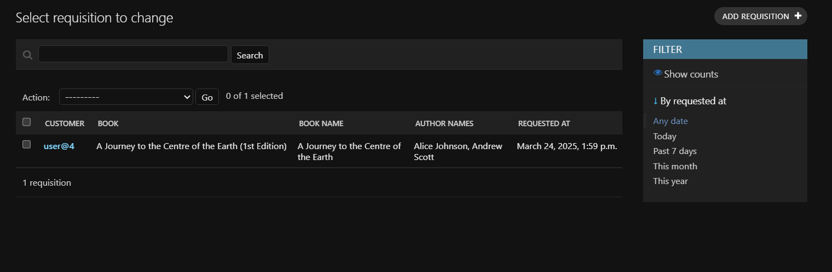
13

Slide 22

WISHLIST
The items user wants to purchase
in future or has interest in is stored in wishlist by the
user for future purchase
14

Slide 23
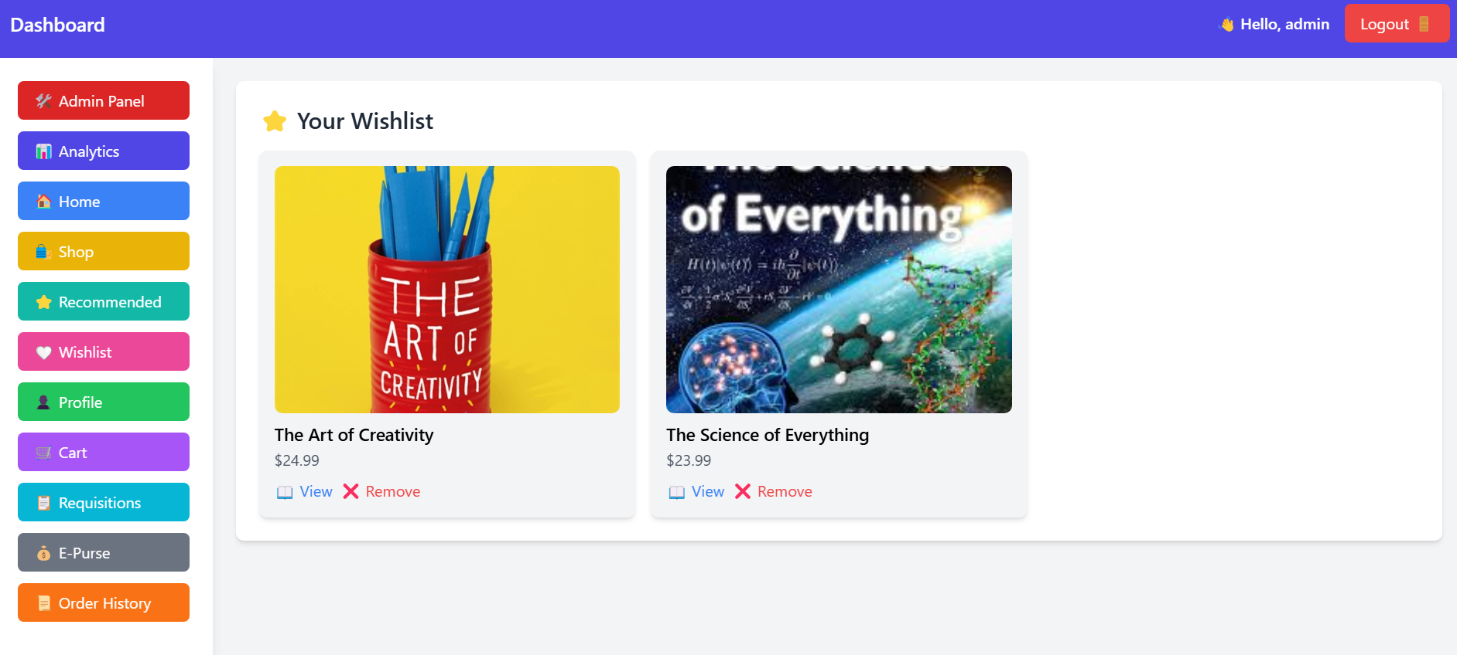
16

Slide 24

REVIEWS
For the book that user has purchased in history customer can write review for other users to view before purchase
15

Slide 25
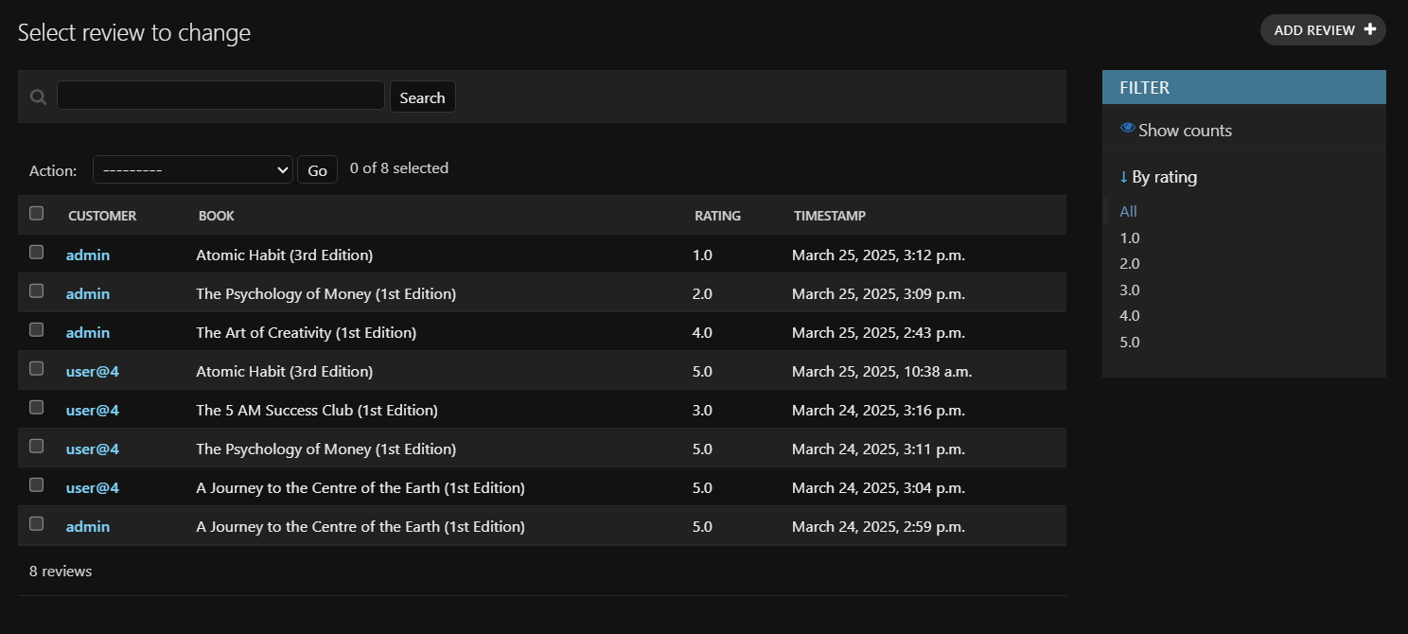
16

Slide 26
AI BASED RECOMMENDATION
Recommend books based on
Past Purchase
Requisition
Wishlist
With customer having similar interest
ML Algorithm used: Apriori Association Algorithm
15

Slide 27
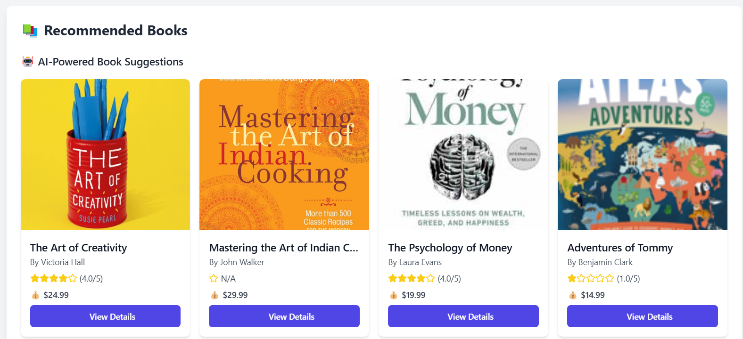
16

Slide 28

EMAIL
The status of the order is conveyed
to the user via Email services
When the product is delivered the user
gets a mail for the same
17

Slide 29
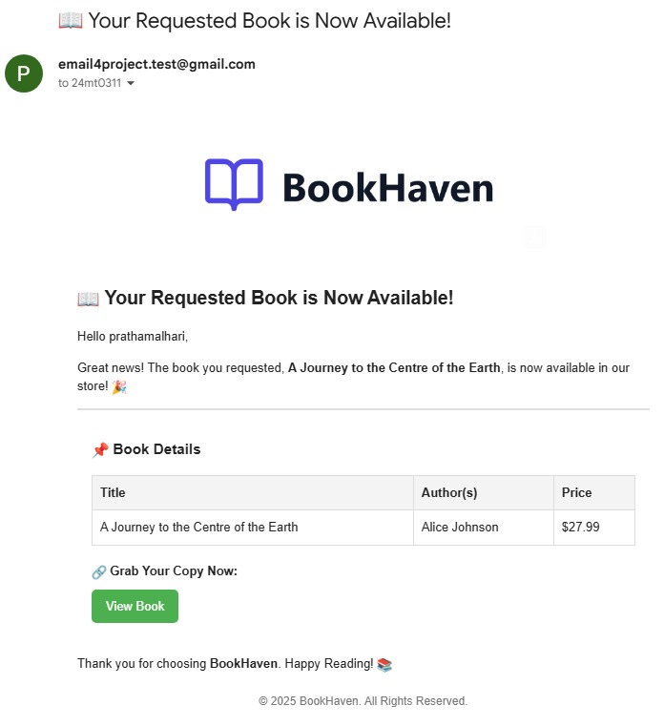
18

Slide 30



THANK YOU
24

